Slide 1
Regression Algorithm

Slide 2
Regression Analysis:
It is used to establish a relationship model between two variables.
One variable is called as predictor variable whose value can be gathered through experiments.
Second variable is called as response variable whose value is derived from predictor variable.
These two variables are also called as
Input variable and Output variable
OR
Independent and Dependent variable
There are few types of Regression Analysis:
Linear
Multiple Linear
Logistic
Polynomial

Slide 3
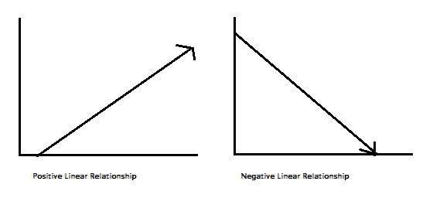
Regression Analysis:
Mathematical equation for linear regression is
y= ax + b
where,
y is response variable (Output variable)
x is predictor variable (Input variable)
a & b are called coefficients.

Slide 4
Types of Variables:
Input Variable / Independent Variable / Predictor Variable:
whose value can be gathered from experiments.
Output Variable / Dependent Variable / Response Variable:
Whose value can be derived from Predictor variable.
Categorical Variable / Discrete Variable / Qualitative Variable:
Variable which has two or more categories.
It is further divided as Nominal, Ordinal and Dichotomous.

Slide 5
Types of Variables:
Nominal Variable: It has two or more categories but no intrinsic order
e.g. Gender (Male / Female), Hair Colour (Brown/Black/Red)
Ordinal Variable: It has two or more categories but it has clear order or rank of the categories.
e.g. Economic status(Low/Medium/High)
Education qualification(School/Graduate/Post Graduate)
Dichotomous Variable: It has only two categories.
e.g. Person owning mobile phone (Yes/No)

Slide 6
Types of Variables:
Continuous Variable / Quantitative Variable:
It has numerical values between any two values.
Which can be measured in quantity.
It can be further divided as Interval and Ratio Variable.
Interval Variable: It has meaningful difference between two values.
e.g. Temperature range between 70 to 80, 81 to 90 and 91 to 100.
CGPA calculation in result
Ratio Variable: It has measurement scale in quantitative nature, It also has meaningful zero value also.
e.g. Age group (0 to 20, 21 to 40, 41 to 60 etc)
Height in Feet (Less than 2 feet, 2 feet to 4 feet, etc)
Weight in Kg (0 to 30 Kg, 31 to 60 kg, etc)

Slide 7
Polynomial Regression:
It is an regression algorithm that models relationship between the dependent variable (Y) and an Independent Variable (X)
as n^{th} degree polynomial.
The equation for this model is as follows:
Y= b₀ + b₁X₁ + b₂X₁² + b₂X₁³ + ...+ b_{n}x₁^{n}
Where,
b₀ is ‘y-axis’ intercept, b₁ is slop coefficient
X1 is independent variable, Y is dependent variable
Polynomial Regression can also called as special case of Multiple Linear Regression.
It makes use of a linear regression model to fit the complicated and non-linear functions and datasets.

Slide 8
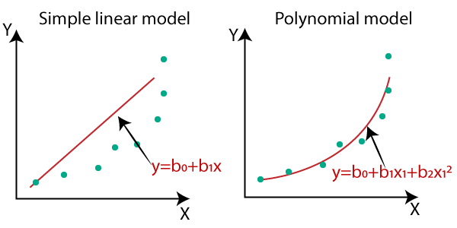
In the above image, we have taken a dataset which is arranged non-linearly.
So if we try to cover it with a linear model, then we can clearly see that it hardly covers any data point.
On the other hand, a curve is suitable to cover most of the data points, which is of the Polynomial model.

Slide 9
Polynomial Regression:
In Polynomial regression, the original features are converted into Polynomial features of required degree (2,3,..,n) and then modeled
using a linear model.
Simple Linear Regression equation: y = b₀+b₁x
Multiple Linear Regression equation: y= b₀+b₁x+ b₂x₂+ b₃x₃+...+ b_{n}x_{n}
Polynomial Regression equation: y= b₀+b₁x + b₂x²+ b₃x³+....+ b_{n}x^{n}
Simple & Multiple Linear Regression are with degree=1
When we add degree >1 in Linear Regression, it becomes Polynomial Regression.

Slide 10
Polynomial Regression:
Suppose we have only one variable, then after applying polynomial features
poly=sklearn.PolynomialFeature(degree=3)
X_poly=poly.fit_transform(X)
e.g.
X = [1, 2, 3, 4, 5]
X_poly = [ 1, x, x2, x3]
[ 1., 1., 1., 1.],
[ 1., 2., 4., 8.],
[ 1., 3., 9., 27.],
[ 1., 4., 16., 64.],
[ 1., 5., 25., 125.]

Slide 11
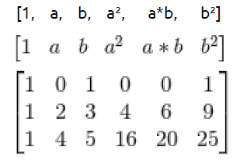
Polynomial Regression:
Suppose we have 2 variable, then after applying polynomial features
poly=sklearn.PolynomialFeature(degree=2)
X_poly=poly.fit_transform(X)
e.g.
X = [[0,1],[2,3],[4,5]]
X_poly =

Slide 12
Polynomial Features:
These features created by raising existing features to an exponent.
Example
If a dataset had one input feature X, then a polynomial feature would be the addition of a new feature (column) where values were calculated by squaring the values in X, i.e. X^2.
This process can be repeated for each input variable in the dataset, creating a transformed version of each.
The “degree” of the polynomial is used to control the number of features added.
Example
Degree of 3 will add two new variables for each input variable.
Typically a small degree is used such as 2 or 3.

Slide 13
Polynomial Features:
Polynomial regression extends the linear model by adding extra
predictors, obtained by raising each of the original predictors to a power.
Example
Cubic regression uses three variables, X, X2, and X3, as predictors.
This approach provides a simple way to provide a non-linear fit to data.
Example of Salary data set

Slide 14
Problem Statement:
We have to predict the salary of a new employee in an organization
based on his position level in his previous company from salary data
for the same position level in the new company.
In this, we have two independent variables “Position” and “Level”.
One dependent variable “Salary”.
So, in this problem we have to train a Polynomial Regression model with this data to understand the correlation between the Level and Salary of the employee data in the company and be able to predict the salary for the new employee based on this data.

Slide 15
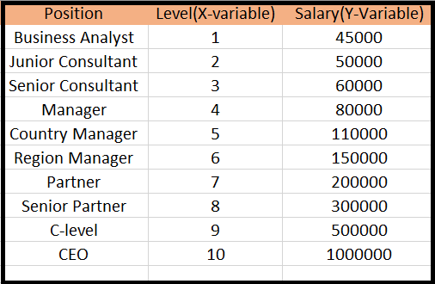
Dataset: “Position_Salaries.csv”

Slide 16
Polynomial Regression:
Steps to prepare Polynomial Regression model:
Data Pre-processing
Build Linear Regression model and fit it to data set
Build Polynomial Regression model and fit it to data set
Visualise the result for Linear Regression and Polynomial Regression
Predict the output.

Slide 17
Step-1: Data Pre-processing
This step is same as you had use it in linear regression model.
Step-2: Importing the library files
import numpy as np
import matplotlib.pyplot as plt
import pandas as pd
Step-3: Read or import the dataset.
data = pd.read_csv("Position_Salaries.csv")
print(data)

Slide 18
Step-4: Creating Dependent and Independent Variable.
X=data.iloc[:,1:2].values # Independent /Input Variable
Y=data.iloc[:,2].values # Dependent /Output Variable
Level is considered as Independent variable and
Salary is considered as Dependent variable.
Step-5: Fitting the Linear Regression Model with given data set.
from sklearn.linear_model import LinearRegression
lin = LinearRegression()
lin.fit(X,Y)

Slide 19
LinearRegression(copy_X=True, fit_intercept=True, n_jobs=None, normalize=False)
Where,
fit_intercept : [boolean, Default is True] Whether to calculate intercept for the model.
normalize : [boolean, Default is False] Normalisation before regression.
copy_X : [boolean, Default is True] If true, make a copy of X else overwritten.
n_jobs : [int, Default is 1] If -1 all CPU’s are used. This will speedup the working for large datasets to process.

Slide 20
Step-6: Fitting the Polynomial Regression model with data set
from sklearn.preprocessing import PolynomialFeatures
poly= PolynomialFeatures(degree=2)
The independent variable X is then fitted with the PolynomialFeatures class and
is converted to a new variable X_poly.
In this, the variable X is converted to a new matrix X_poly which consists of
all the polynomial combinations of features with degree=2.
X_poly = poly.fit_transform(X)
lin2=LinearRegression()
lin2.fit(X_poly, Y)

Slide 21
scikit-learn (sklearn):
Most commonly used package containing functionality supporting supervised and unsupervised learning.
It provides tools for model development, selection, evaluation, data preprocessing.
It is installed using package name scikit-learn, and imported using sklearn

Slide 22
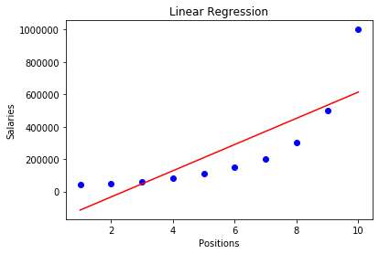
Step-7: Visualise the Linear Regression Model by using Matplotlib
plt.scatter(X,Y, color='blue')
plt.plot(X, lin.predict(X), color='red')
plt.title("Linear Regression")
plt.xlabel('Positions')
plt.ylabel('Salaries')
plt.show()

Slide 23
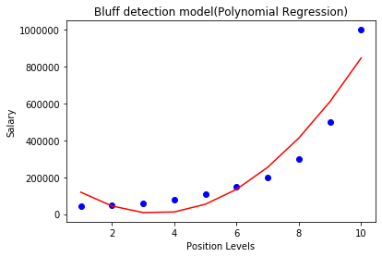
Step-8: Visualise the Polynomial Regression Model by using Matplotlib
plt.scatter(X, Y, color='blue')
plt.plot(X,lin2.predict(poly.fit_transform(X)),color='red')
plt.title('Polynomial Regression')
plt.xlabel("Positions")
plt.ylabel("Salaries")
plt.show()

Slide 24
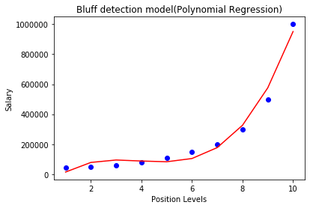
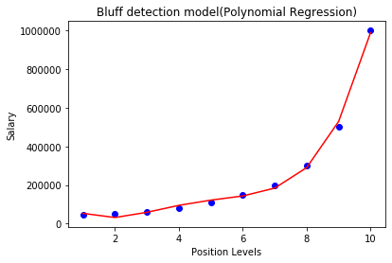
Step-9: If we change the degree to 3, 4 and 5, then
we will get more accurate plot.
Degree=3 Degree=4
We can choose the degree of polynomial based on the relationship between target and predictor.

Slide 25
With the increasing degree of the polynomial, the complexity of the
model also increases.
Therefore, the value of n must be chosen precisely.
If this value is low, then the model won’t be able to fit the data properly and if high, the model will over fit the data easily.
Step-9: Predicting the final result with Polynomial Regression Model
poly_pred = lin2.predict(poly.fit_transform([[7]]))
print(poly_pred)
[201349.65034936]

Slide 26
Step-9: Comparing Real Values and Predicted values
y_pred = lin_reg.predict(X_poly)
df = pd.DataFrame({'Real Values':Y, 'Predicted Values': y_pred})
print(df)
Real Values Predicted Values
0 45000 43895.104896
1 50000 53836.829837
2 60000 57065.268065
3 80000 77286.713286
4 110000 112263.403263
5 150000 152736.596736
6 200000 201349.650349
7 300000 291571.095571
8 500000 506617.715618
9 1000000 998377.622378

Slide 27
Polynomial Regression Example:
Train-Test Split for Evaluating Machine Learning Algorithms:
The train-test split procedure is used to estimate the performance of machine learning algorithms when they are used to make predictions on data not used to train the model.
It is a fast and easy procedure to perform, the results of which allow you to compare the performance of machine learning algorithms for your predictive modeling problem.
The train-test split procedure is appropriate when you have a very large dataset,
a costly model to train, or require a good estimate of model performance quickly

Slide 28
Train-Test Split for Evaluating Machine Learning Algorithms:
The procedure involves taking a dataset and dividing it into two subsets.
The first subset is used to fit the model and is referred to as the training dataset.
The second subset is referred to as the test dataset.
Train Dataset: Used to fit the machine learning model.
Test Dataset: Used to evaluate the fit machine learning model.
This procedure is useful for sufficiently large dataset.
It means that there is enough data to split the dataset into train and test datasets and each of the train and test datasets are suitable representations of the problem domain.

Slide 29
Train-Test Split for Evaluating Machine Learning Algorithms:
Conversely,
The train-test procedure is not appropriate when the dataset available is small.
The reason is that when the dataset is split into train and test sets, there will not be enough data in the training dataset for the model to learn an effective mapping of inputs to outputs.
There will also not be enough data in the test set to effectively evaluate the model performance.
The common split percentages include:
Train: 80%, Test: 20%
Train: 67%, Test: 33%
Train: 50%, Test: 50%

Slide 30
Train-Test Split for Evaluating Machine Learning Algorithms:
The implementation of train test split procedure is available in the
scikit-learn module with train_test_split() function.
e.g.
from sklearn.model_selection import train_test_split
X_train, X_test, y_train, y_test = train_test_split(X, y, test_size=1/3.0, random_state=0)
Where,
The function takes a loaded dataset (X & y) as input and returns the dataset split into two subsets.
The size of the split can be specified via the “test_size” argument
random_state =0/1 sets same random numbers of records for all.
Example:
Polynomial Regression.ipynb

Slide 31
Random Forest Regression Algorithm:
Random Forest is supervised learning algorithm.
It combines multiple decision trees to determine the final output.
i.e.
It builds multiple decision trees and merges there predictions together to get more accurate prediction.
It uses Ensemble learning technique (using multiple algorithms at a time or single algorithm multiple times) to make more powerful model.
Working:
It builds several decision trees at random data points.
Then taking average of there predictions.
Taking average is better than that of single decision tree value.

Slide 32
Random Forest Regression Algorithm:
In this algorithm, either random sampling of training data is used,
or random variables or features are used.
Steps for Random Forest Regression:
Step-1: Select the ‘k’ random data points from the training set.
Step-2: Build the decision trees associated with ‘k’ data points.
Step-3: For each of decision trees predict the value of ‘Y’.
Step-4: Take an average of all predicted values at ‘Y’.

Slide 33
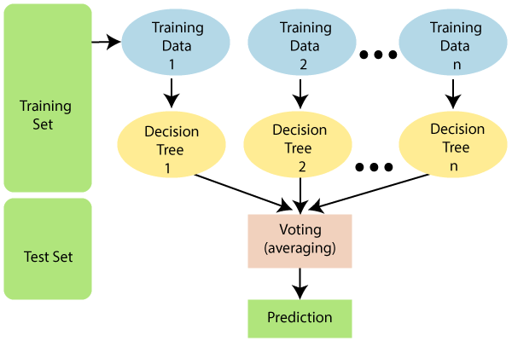
Random Forest Regression Algorithm:

Slide 34
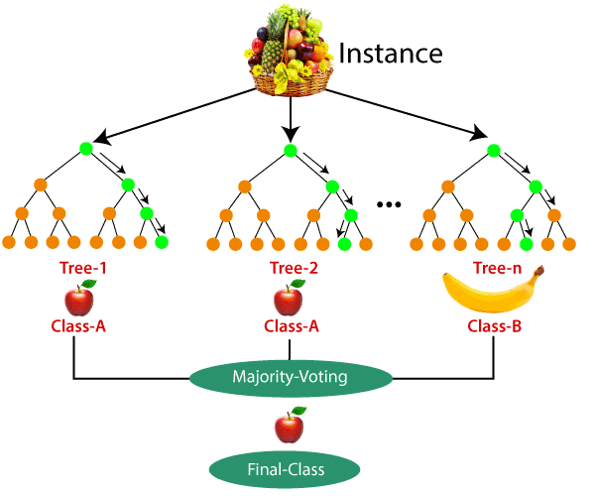
Random Forest Regression Algorithm:

Slide 35
Random Forest Regression Algorithm:
Real life example
I want to decide where to go during one-month vacation,
So I asks the people whom I know best for suggestions.
The first friend asks me about the likes and dislikes of my past travels.
Based on the answers, he will give me some advice.
Afterwards,
I starts asking more and more of my friends to advise me and
they again ask me different questions they can use to derive some
recommendations from.
Finally,
I chooses the places that where recommend the most to me.
This is the typical random forest algorithm approach.

Slide 36
Random Forest Regression Algorithm:
Problem statement:
Petrol Consumption data set contains columns like
Petrol Tax
Per capita income
Number of miles of paved highway
Proportions of drivers
Consumption of petrol
We have to predict the petrol consumption by considering all the input parameters.
Example: Random Forest Regression.ipynb

Slide 37
Random Forest Regression Algorithm:
We can fit the model as follows:
regressor = RandomForestRegressor (n_estimators =100,random_state=0)
regressor.fit(X_train, y_train)
Important parameters:
n_estimators: Number of trees the algorithm builds before averaging the predictions.
max_features: Maximum number of features random forest considers splitting a node.
n_jobs: It tells the engine how many processors it is allowed to use. If the value is 1, it can use only one processor but if the value is -1 there is no limit
random_state: Controls randomness of the sample.

